Slide 1
Multi-terabyte
Database Migration
Across O.S. Platforms
A Case Study from the
2004-2006 Platform Migration in
Personal Lines Data Warehouse,
The Hartford Financial Services Group, Inc.
V. 2005-05-05

Slide 2
Presenters
Saran Shanmugam
  9i Oracle Certified Master
  DBA Team Lead for the platform migration
James Madison
  Application Development Enterprise Architect
  Project Manager for the platform migration

Slide 3
Agenda
The Challenge (James)
Database Technology Used (Saran)
Introduction to Transportable Tablespaces (Saran)
Introduction to Data Pump (Saran)
Pre-Migration Database Preparation (Saran)
Database Migration Process (Saran)
Environmental Problems and Solutions (James)
Application Problems and Solutions (James)
Q&A

Slide 4
The Challenge
To move 22 TB of data in 17 databases on 9i
Largest single database is 7 TB
OS changes: from Tru64 to HP-UX
Operating systems use different endian’s
Forced to go to 10g due to the endian change
OS and database change causes 8 other upgrades
Complex application logic must be considered
All with a high management profile due to cost
(The O.S.’s discussed are Tru64 and HP-UX, but the principles apply to any disparate O.S.’s)

Slide 5
Technologies Considered for Data Migration
Exp/Imp - Available with 9i and 10g
Data pump - Available with Oracle 10g
Cross Platform Transportable Tablespace - Available with Oracle 10g
Third party tools - Not recognized by Oracle

Slide 6
Technology Decision for Data Migration
Exp/Imp for metadata transfer
Cross Platform Transportable Tablespace and Data Pump - For data Transfer
Times faster than any available methods
Just 3% slower than any regular copy of datafiles

Slide 7
Transportable Tablespace - A background
Introduced in 8i
TTS between multi-block databases in Oracle 9i
TTS between multiplatform databases in Oracle 10g
- Compatibility need to be greater than 10.0.0

Slide 8
Cross Platform Transportable Tablespace Features
Higher loading speeds
Reduced server burden
Reduced complexity of process
No creation or rebuilding indexes
Movement of tablespace between multiple O.S. platforms
Sharing of Tablespaces between different O.S. Servers but with same endians

Slide 9
Data Pump Export/Import Utility - Overview
New with 10g
Server-based Tool
Faster data movement than Export/Import
PL/SQL Package DBMS_DATAPUMP allows easier automation
Web interface available
Direct transfer of metadata through database network link

Slide 10
Mapping between EXP & EXPDP Parameters
Export Utility | Data Pump Utility
CONSISTENT | A parameter comparable to CONSISTENT is not needed. Use FLASHBACK_SCN and FLASHBACK_TIME for this functionality.
FILE | DUMPFILE
FLASHBACK_SCN | FLASHBACK_SCN
FLASHBACK_TIME | FLASHBACK_TIME
FULL | FULL
LOG | LOGFILE
OWNER | SCHEMAS
PARFILE | PARFILE
ROWS=N | CONTENT=METADATA_ONLY
ROWS=Y | CONTENT=ALL
TABLES | TABLES
TABLESPACES | TABLESPACES (Same parameter; slightly different behavior)
TRANSPORT_TABLESPACE | TRANSPORT_TABLESPACES (Same parameter; slightly different behavior)
TTS_FULL_CHECK | TRANSPORT_FULL_CHECK

Slide 11
Mapping between IMP & IMPDP Parameters
Import Utility | Data Pump Utility
DATAFILES | TRANSPORT_DATAFILES
DESTROY | REUSE_DATAFILES
FILE | DUMPFILE
FROMUSER | SCHEMAS
FULL | FULL
GRANTS | EXCLUDE=GRANT and INCLUDE=GRANT
HELP | HELP
IGNORE | TABLE_EXISTS_ACTION
INDEXFILE | SQLFILE
LOG | LOGFILE
ROWS=Y | CONTENT=ALL
SHOW | SQLFILE
TABLESPACES | This parameter still exists, but some of its functionality is now performed using the TRANSPORT_TABLESPACES parameter.
TOUSER | REMAP_SCHEMA
TRANSPORT_TABLESPACE | TRANSPORT_TABLESPACES (see command description)
TTS_OWNERS | A parameter comparable to TTS_OWNERS is not needed because the information is stored in the dump file set.

Slide 12
Benefits of the O.S. and Hardware Preparations
Migration time reduced by 50%
  Required extensive testing
  Did a network and server proof of concept
  Experimented with various parameters
  Created custom utilities and scripts to pin-point bottlenecks

Slide 13
Overall Plan
Determine Source and Target Platform
Upgrade server O.S. to TRU64 5.1b
Upgrade Databases from 9.2.0.x to Oracle 10.1.0.3
Set Compatibility to 10.0.0
NFS mount source database filesystems to the target server
Determine the time for converting 7 TB
Group filesystems with gigabit connections between source and target server
Run Migration Process

Slide 14
Overall Plan Flow
Migrate to TRU64 5.1b
Upgrade database to
10.1.0.3
4 mo.s
2 mo.s
3 mo.s
Set database
Compatibility to 10.0.0
OS to Tru 64 5.1a
RDBMS Oracle 9i R2
4 mo.s
Migrate to HP-UX
11.23

Slide 15
Determine Source and Target Platform and Cross Platform TTS Support
SELECT * FROM
V$TRANSPORTABLE_PLATFORM;
  See results on next slide…
TRU64 Cross Platform transportable tablespaces
  Not supported in 10.1.0.2
  Bug #3729392
  Bug #3710656

Slide 16
PLATFORM_ID | PLATFORM_NAME | ENDIAN_FORMAT
1 | Solaris[tm] OE (32-bit) | Big
2 | Solaris[tm] OE (64-bit) | Big
7 | Microsoft Windows IA (32-bit) | Little
10 | Linux IA (32-bit) | Little
6 | AIX-Based Systems (64-bit) | Big
3 | HP-UX (64-bit) | Big
5 | HP Tru64 UNIX | Little
4 | HP-UX IA (64-bit) | Big
11 | Linux IA (64-bit) | Little
15 | HP Open VMS | Little
8 | Microsoft Windows IA (64-bit) | Little
9 | IBM zSeries Based Linux | Big
13 | Linux 64-bit for AMD | Little
16 | Apple Mac OS | Big
12 | Microsoft Windows 64-bit for AMD | Little
17 | Solaris Operating System (x86) | Little

Slide 17
Upgrade server O.S.
Oracle 10g Compatible O.S.
  Tru64 5.1b
  HP-UX 11.11

Slide 18
Upgrade Databases to 10G
dbua - recommended Method
Manual upgrade is the method being considered
  Control on the upgrade process
Direct upgrade to 10.1.0.3 supported
Check for next extent size in the system tablespace
Partial Clone can be built and upgraded to check for upgrade issues.
Set Compatibility to 10.0.0
  No turning back after setting compatibility

Slide 19
O.S. and Hardware Preparations
O.S. level filesystem layout
a) Standardization on the filesystem size for
optimized performance
O.S. NFS layout
a) NFS mounts over the private gigabit Ethernet
b) For maximum throughput, dedicated use of the gigabit Ethernet
O.S. Gigabit connectivity
a) If possible multiple gigabit paths
O.S. Processes must be increased
a) Several dozen NFSD processes on source
b) Several dozen BIOD processes on target

Slide 20
Hardware Layout
TRU64 Server
HP–UX Server
Gigabit
Connectivity
NFS Mount
Data Store
Data Store

Slide 21
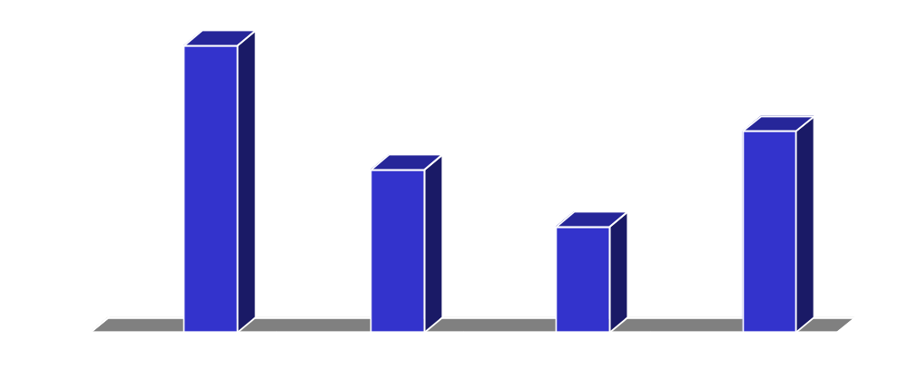
Tuning of the Data Migration
Determine the optimum rate of parallelism with 1 gigabit connectivity
- Parallelism 3 works best for test case - 15 GB converted in 11 mins.
For production, setup additional 3 Gigabit connections to achieve conversion rate of 7TB/25 hours approx.
Time in mins
1
2
3
4
Parallelism

Slide 22
Migration Process
1. Meta Data Export with Rows=n and Full=y
2. Default Application Tablespaces Creation in Target Database
3. Meta Data Import in Target Database
4. Drop Application Tablespaces in the Target Database
5. Cross Platform Transportable Tablespace Plug-in
6. Meta Data Import into Target Database with Ignore=y
- To take care of Materialized Views, Function-based Indexes, Triggers, Constraints, Grants.
7. Validate the Database Structures
- LOB will undergo automatic endian conversion
- If Database is in AL16UTF16 character set then no conversion is needed.
- Check for Directories and External Tables

Slide 23
Migration Process Flow
Export
Row= n
Fully = y
Create application tablespaces
Check for tts
validation
Import Metadata
Convert to big endian
Place tablespaces
In read only mode
Plug in tablespaces pulling
Metadata over dblink
TRU 64
HP - UX
Yes
All objects
Available ?
No
Go to bar &
Have beer
Check and fix
issues And errors

Slide 24
Meta Data Export and Import Scripts
To do a export of metadata of database
- exp system/**** row=n full=y file=dtest.dmp
To import and create users
- imp system/**** file=dtest.dmp full=y
To Collect all the Materialized Views and Function Based Indexes scripts
- imp system/**** file=dtest.dmp indexfile=ss.sql
To reimport all objects and compile other objects
- imp system/**** file=dtest.dmp ignore=y full=y compile=y

Slide 25
Cross Platform Transportable
Tablespace Execution Steps
 | Processes | Comments
1 | Determine Source and Target Platforms | SELECT * FROM V$TRANSPORTABLE_PLATFORM;
2 | Check for transportable tablespace violations in source database | execute dbms_tts.transport_set_check ('ts1,ts2',true);
3 | Take the tablespaces to be transported in Source database into read only mode | alter tablespace ts1 read only;
4 | Drop the same tablespaces in the Target database or rename the tablespace | If you have the same tablespace existing in Target database
5 | Drop the same tablespaces in the second Target database too | If the tablespaces are shared between two databases
6 | Create the user concerned in the Target database | If User does not exist in the Target database
7 | copy and convert the datafiles of the tablespaces from Source to Target Database | run copy scripts simultaneously
8 | Import meta data into Target Database | run Import script
9 | Make the tablespace read write in both Source and Target databases if the tablespace is not shared | If the tablespace is not shared between two databases

Slide 26
Cross Platform Transportable Tablespace Process
Detailed Commands and SQL Statements
1. Check the source and target Platform and endian format of these databases.
SELECT * FROM V$TRANSPORTABLE_PLATFORM;
2. Check for the tablespace’s TTS violations.
EXECUTE DBMS_TTS.TRANSPORT_SET_CHECK ('TS1,TS2',TRUE);
3. Place the tablespace in read-only mode.
ALTER TABLESPACE TEST01 READONLY;
4. Create directory for the data pump.
CREATE DIRECTORY EXP_DIR AS '/tmp2/dev/export';
5. Grant the privilege to read the directory to the user oraop(if a separate userid with DBA privilege is used) – Need to be run as “SYSTEM” user.
GRANT READ ON DIRECTORY EXP_DIR TO ORAOP;
6. Run data pump export of metadata.
expdp ORAOP/********
DUMPFILE=EXP_DIR:crstts.dat
LOGFILE=exp_dir:crstts.log
JOB_NAME=METADATA_EXP
TRANSPORT_TABLESPACES=SS
Cont...

Slide 27
Cross Platform Transportable
Tablespace Execution Steps (cont.)
7. Convert the tablespace’s datafiles if the endian formats vary. In our case TRU64 has a endian format of little and it needs to be converted to big, which is the format of HP-UX. Target based conversion is preferable.
rman target /
Recovery Manager: Release 10.1.0.3.0 - 64bit Production
Copyright (c) 1995, 2004, Oracle. All rights reserved.
connected to target database: DTEST (DBID=192664513)
run {
allocate channel d1 device type disk;
allocate channel d2 device type disk;
allocate channel d3 device type disk;
CONVERT DATAFILE '/plad02/oradata/dtest/ss01.dbf','/plad03/oradata/dtest/ss02.db
f','/olap003/oradata/dtest/ss03.dbf' FROM PLATFORM 'HP Tru64 UNIX' DB_FILE_NAME_
CONVERT '/plad02','/test001','/plad03','/test002','/olap003','/test003';
}
8. Run data pump import of meta data.
impdp readonly/********
DIRECTORY=exp_dir
DUMPFILE=crstts.dat
TRANSPORT_DATAFILES=’/plad01/oradata/dtest2/test01.dbf’

Slide 28
Other Options considered for Cross Platform Transportable Tablespace
dbms_streams_tablespace_adm.pull_tablespaces procedure
- Makes any read/write tablespace in the specified tablespace set at the remote database read-only
- Uses Data Pump to export the metadata for the tablespaces in the tablespace set
- Uses a database link and the DBMS_FILE_TRANSFER package to transfer the datafiles for the tablespace set and the logfile for the Data Pump export to the current database
- Places the datafiles that comprise the specified tablespace set in the specified directories at the local database
- Places the log file for the Data Pump export in the specified directory at the local database
- If this procedure made a tablespace read-only, then makes the tablespace read/write
- Uses Data Pump to import the metadata for the tablespaces in the tablespace set at the local database
- In addition, this procedure optionally can create datafiles for the tablespace set that can be used with the local platform, if the platform at the remote database is different than the local database platform.
Why wasn't it considered?
- Lack of Control
- Error Prone

Slide 29
Non-Database Challenges
Many difficult elements of a migration are not directly related to the database, but the DBA’s will get drawn into them, so it’s good to be ready.
Non-database challenges fall into these categories:
  Environmental configuration
  Application logic
  Organizational Issues

Slide 30
Environmental Configuration:
Version Compatibility
The change of O.S. and database versions may force a number of other upgrades
We had to upgrade 7 before we could do 10g
Items to consider are:
  ETL software
  Scheduling software
  Business intelligence software
  IDE’s and other developer suites
  System monitoring tools
  Connectivity drivers such as ODBC and JDBC
  Oracle client versions
The last two could propagate to entire user base

Slide 31
Environmental Configuration:
Tools Not Ready for 10g
One of the above for us could had no product compatible with 10g for the near future
We made the decision to keep a small 9i instance running.
  This was possible because the instance needed by the vendor product was tiny.
  Not going to 10g is fine for small instances but would not have worked for the major warehouse instances.

Slide 32
Non-Database Challenges:
Solution Summary (evolving)
Determine other forced version upgrades.
Plan to leave one or more databases at 9i.
More to come…

Slide 33
Environmental Configuration:
UNIX Setup
Actions to take:
  Get everyone on the same .profile
    If possible, do as a best practice well before the migration
  Use environmental variables for all values that may vary by environment:
    ORACLE_SID, ORACLE_HOME, and other Oracle values.
    LIBPATH, PERL5LIB, and other library references.
    Values for AutoSys, Informatica, and other major tools.
Benefits:
  Code not affected by environmental changes.
  Can intercept commands with alias’s and custom code.

Slide 34
Non-Database Challenges:
Solution Summary (evolving)
Determine other forced version upgrades
Plan to leave one or more databases at 9i
Get on the same .profile for all systems and users
Make sure code uses environmental variables
More to come…

Slide 35
Application Logic:
The Issues
Keys cross all systems: batch ID, policy ID, vehicle ID, driver ID (a.k.a global keys)
Many systems join tables between them
Dozens of unrelated applications reside in a handful of schemas
Applications are not 1-1 to tablespaces, so clean transport at application level is difficult
Database code is not “wrapped” into a single point of entry—database is hit any number of ways

Slide 36
Application Logic:
Application Move Approaches
Piece-wise
Big-bang
Exponential
Client-Server Exponential

Slide 37
Application Logic:
Piece-wise Move
Move one or a few applications at a time including both code and data
Pros:
  Perfectly viable. Another area in the company did this.
  Low risk as small pieces move one or a few at at time.
  Many tools available for the low-volume data flow.
Cons:
  Likely need third-party tool, thus training and cost.
  Most critical concern: extremely slow.

Slide 38
Application Logic:
Big-Bang Move
Move everything (code, data, feeds, customers) all at once: Friday = Tru64, Monday = HP. One shot.
Pros:
  Completely solves the global key and cross-join issues.
  If it works, you are done soon, and thus derive ROI soon.
Cons:
  Risk--the odds of it all working at once are slim.
  Lots of prep work to do it all in 48 hours: trial runs, script everything, add abstraction layers, coordinate customers.

Slide 39
Application Logic:
Exponential
Move smaller, fairly self-contained systems, work up to more inter-dependent systems
Pros:
  Starts small so risk is more easily managed
  Big-bang-like toward end to get past global IDs and joins
Cons:
  Timeline is longer than big bang (but not as risky)
  Riskier than piece-wise (but faster)

Slide 40
Application Logic:
Client/Server Exponential
Move the databases first, move the applications second, small to big in both cases.
Pros:
  Gave early ROI by getting off old storage ASAP
  Made one big plan into two more manageable
  Only one layer at a time dealing with planning or fallout
Cons:
  Systems had never run in a client/server design (7 years)

Slide 41
Application Logic:
Client/Server Exponential Challenges
Technical challenges:
  ORACLE_SID does not function remotely
  UTL_FILE writes to the database’s local machine
    More of a problem with utl_file_dir = *
  External files are read from the database’s local machine
  OPS$ needs REMOTE_OS_AUTHENT=TRUE
    Security hole as it is easily spoofed.
  Have to juggle dozens/hundreds of TNSNAMES.ORA as part of the weekend move
Each of these have fairly easy solutions
  “Fairly easy” meaning very minimal application code changes.

Slide 42
Application Logic:
Client/Server Exponential Solutions
ORACLE_SID does not function remotely
  export TWO_TASK=$ORACLE_SID
  Note: TWO_TASK requires TNS_ADMIN to be set
UTL_FILE writes to the database’s machine
  Read-write NFS mount back to the Tru64 server
External files are read from the database’s machine
  Read-only NFS mount back to the Tru64 server
OPS$ needs REMOTE_OS_AUTHENT=TRUE
  Logon trigger: if “like OPS$ and not on an authorized server” then “disconnect”
Make REMOTE_LISTENER old listener
  Postpones change of TNSNAMES.ORA to after move

Slide 43
Non-Database Challenges:
Solution Summary (evolving)
Determine other forced version upgrades
Plan to leave one or more databases at 9i
Get on the same .profile for all systems and users
Make sure code uses environmental variables
Understand the effect of application complexity
Determine your overall approach (not just data)
More to come…

Slide 44
Organizational Issues:
A Very Brief Discussion
There are many, but the big ones are:
If the DBA’s don’t own root on the servers, get a UNIX workstation in your lab where you do
Get a fast-track policy to by-pass change control until the new servers are 100% in production
Map out the DBA area of responsibility and empower those before and after it:
  Write clear requirements for the areas that support the DBA team: server, storage, networking, backup teams
  Don’t get drawn in to application layer issues

Slide 45
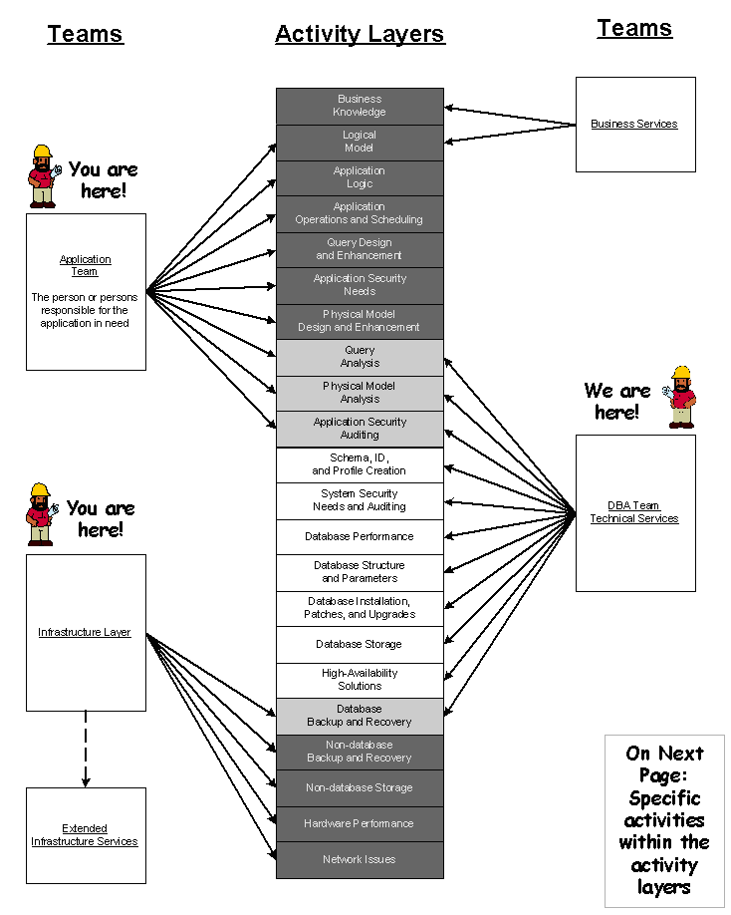
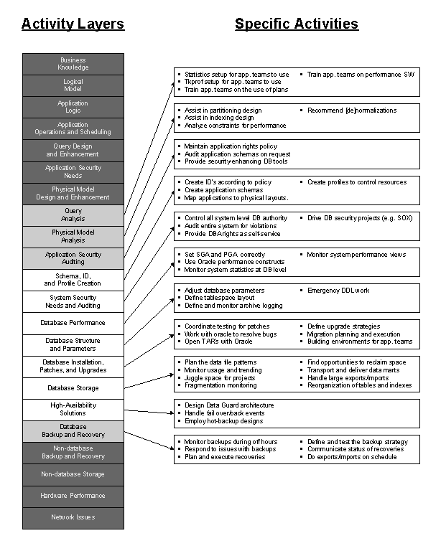
Examples of the kinds of documents that help focus the DBA role during the migration. In addition, SLA’s should be clear and repeatedly published

Slide 46
Non-Database Challenges:
Solution Summary
Determine other forced version upgrades
Plan to leave one or more databases at 9i
Get on the same .profile for all systems and users
Make sure code uses environmental variables
Understand the effect of application complexity
Determine your overall approach (not just data)
Find a way to fast-track changes and have root
Put your needs for other areas in clear specs early
Train and empower application folks or get flooded

Slide 47
Thanks
Mike Gagne
Devesh Pant
Sundar Palani
Frank Ortiz
Sue Honeyman
Ian Penman

Slide 48
Questions and Answers
Open discussion

Slide 49
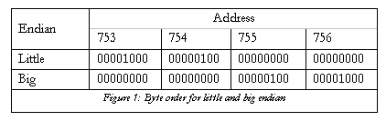
Appendix A -- Endian
Consider the decimal number 1032. This is 10000001000 in binary. If we assume a 32-bit word, pad with 0's accordingly, and put in spaces every eight bits for readability, we have: 00000000 00000000 00000100 00001000. If these bytes are to be written into the four byte addresses 753 - 756, they would have the configurations shown in the table for little and big endian. To remember how this works, either remember that we as human beings write numbers in big endian, or use the three L's: Little endian puts the Least significant byte in the Lowest address.

